Slide 1

RV College of Engineering®
VII SUMMER INTERNSHIP (22CS276SI):Review-II
Video Wall Application
Risheek S
1RV22CS160
Department of Computer Science,
R V College of Engineering, Bengaluru.
Go, change the world®

Slide 2
RV College of Engineering®
Go, change the world®
METHODOLOGY
The development of the video wall system followed a systematic and iterative methodology. Initially, requirements were analyzed to understand streaming, display, and recording needs for surveillance applications. Based on these requirements, a scalable system architecture was designed to support multiple concurrent RTSP video streams.
The implementation phase involved developing modular multimedia pipelines using the GStreamer framework and Python. Real-time video streams were decoded, processed, and rendered in a grid-based graphical user interface. Performance optimization, debugging, and stability testing were carried out iteratively to ensure reliable long-term operation.
Finally, the system was validated through functional and performance testing, and comprehensive documentation was prepared to support deployment, maintenance, and future enhancements.

Slide 3
RV College of Engineering®
Go, change the world®
Results Discussion
The developed video wall system successfully demonstrated the ability to ingest, process, and display multiple live RTSP video streams simultaneously in a grid-based layout. The system was able to maintain smooth playback and acceptable latency across all video feeds, validating the effectiveness of the designed multimedia pipeline architecture.
Performance evaluation showed that the use of hardware-accelerated video sinks significantly reduced CPU utilization while improving rendering efficiency. This allowed the system to scale to multiple high-resolution streams without noticeable frame drops. Proper buffering and queue management within the GStreamer pipelines contributed to stable long-term operation.
The implementation of split-muxed recording enabled reliable storage of video streams in segmented files, improving fault tolerance and ease of playback. Issues related to memory growth and pipeline instability were identified during testing and resolved through systematic debugging of caps negotiation and buffer handling mechanisms.
Overall, the results indicate that the developed solution is suitable for real-time surveillance and monitoring applications. The project highlights the importance of careful pipeline design, performance optimization, and robust debugging practices in building scalable and reliable multimedia systems.

Slide 4
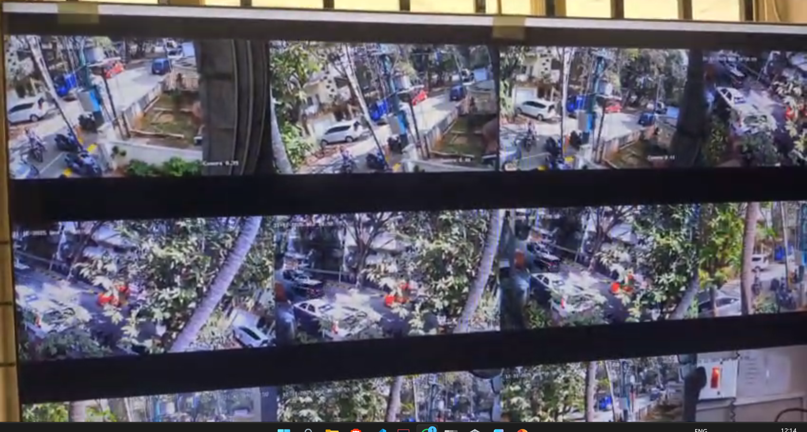
RV College of Engineering®
Go, change the world®

Slide 5
RV College of Engineering®
Go, change the world®
Understanding of Resource Management
Effective resource management was a key consideration during the development of the video wall system, as the application involved continuous processing of multiple real-time video streams. Computational resources such as CPU, memory, GPU, and network bandwidth were carefully monitored and optimized to ensure stable and efficient system performance.
CPU and GPU resources were managed by leveraging hardware-accelerated decoding and rendering wherever possible, thereby reducing processing overhead on the CPU. The use of optimized multimedia pipelines and appropriate queue configurations helped balance workload distribution across processing threads, preventing bottlenecks and ensuring smooth playback of video streams.
Memory utilization was closely observed to avoid leaks and excessive buffer accumulation during long-running operation. Proper buffer handling, caps negotiation, and controlled allocation of pipeline elements contributed to consistent memory usage over time. Additionally, network resources were managed by optimizing stream configurations and ensuring reliable data flow from RTSP sources.
Overall, systematic resource management practices played a crucial role in achieving a scalable, reliable, and high-performance video wall system suitable for continuous operation in surveillance and control room environments.

Slide 6
RV College of Engineering®
Go, change the world®
Awareness of Environmental & Sustainability Practices
The organization demonstrates awareness of environmental and sustainability practices by promoting efficient use of resources and responsible technology deployment. Energy-efficient system designs, optimized resource utilization, and reduced hardware dependency help minimize power consumption and environmental impact. By adopting sustainable operational practices and encouraging responsible use of technology, the organization contributes to environmentally conscious and sustainable development.

Slide 7
References
RV College of Engineering®
Go, change the world®
Research Papers:
Leonardo Peroni & Sergey Gorinsky — An End-to-End Pipeline Perspective on Video Streaming in Best-Effort Networks
ACM Computing Surveys paper offering a holistic view of the entire video streaming pipeline (ingestion → processing → playback), useful for pipeline architecture discussions.
(Optional) “Flexible Architecture for Real-time Processing of Multiple Video Signals”
A paper on flexible multi-video signal processing architectures — helpful when discussing scalability and multi-stream handling.
(Optional) “Distributed Deep Learning Model for Intelligent Video Surveillance Systems”
Useful if you want to reference modern surveillance system architecture with edge computing integration.
Text Books/Reference books
1. Multimedia Networking — Chapter in Computer Networking: A Top-Down Approach
A foundational textbook chapter explaining multimedia networking concepts, streaming, and protocols (RTSP, RTP, codecs).
RTP/RTSP Protocol Overview (Jain’s Lecture Notes)
A detailed academic explanation of RTSP alongside RTP for real-time multimedia delivery over networks.
RFC 2326 — Real Time Streaming Protocol (RTSP)
The official protocol specification for RTSP, defining how streaming sessions are controlled between client and server.

